Slide 1
Chapter:3.1
Bonding and the periodic table

Slide 2
Atoms tend to form chemical bonds to obtain a filled valence shell and become chemically stable.
Chemical bonds are due to the electrostatic force of attraction between positive and negative charges in participating atoms.

Slide 3
There are three types of chemical bonds
Metallic bond: The electrostatic force of attraction that holds metal atoms together; acts between negatively charged delocalised valence electrons and positively charged metal cations.

Slide 4
Ionic bonds: Involve the electrostatic force of attraction between positively charged cations and negatively charged anions; results in an ionic compound with a three-dimensional lattice structure.
Covalent bonds: This involve electrostatic attraction between shared negatively charged electrons and positively charged nuclei; results in a molecule or covalent lattice.

Slide 5
Valency is the combining power of an atom and is equal to the number of hydrogen atoms that atom could combine with or dis[p[lace from a compound. Hydrogen has valency of 1.
Do Q: set 3.1 Q’s: 3, 4, 6 (a & b)& 7a.

Slide 6
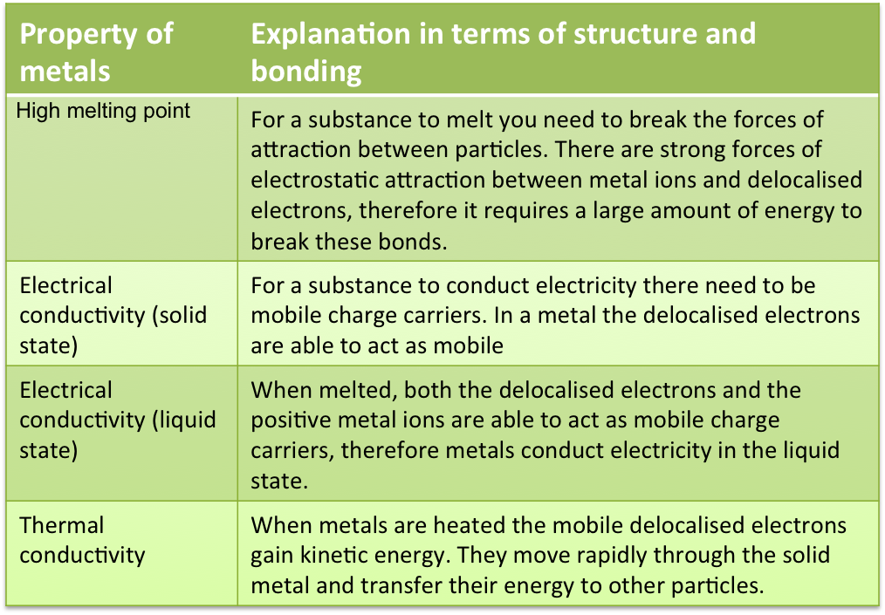
Chapter: 3.2 metals, bonding & properties

Slide 7
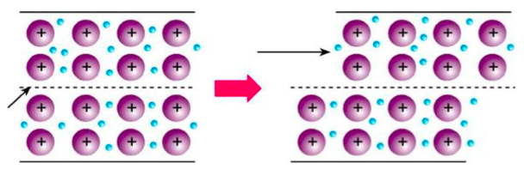
Malleability & Ductility | The force of attraction between metal ions and delocalised electrons in non-directional. When a force is applied a row of ions is able to move into a new position without breaking metallic bonds.

